Slide 1
AUTOMATIC WATER DISPENSER
MAHATMA EDUCATION SOCIETY’S
PILLAI COLLEGE OF ENGINEERING , NEW PANVEL
ELECTRONICS & TELECOMMUNICATION DEPARTMENT
UNDER THE GUIDANCE OF
PROF. ISHMEET SINGH RIAR
GROUP B1-2
02 DIVYA MOKAL
15 ADITI PATIL
16 KANCHAN PATIL
17 NIKITA PATIL
21 TEJAS POTE
DATE : 18 /12 / 2020
SE EXTC B , SEMESTER III , A.Y 2020-21

Slide 2
AUTOMATIC WATER DISPENSER

Slide 3
CONTENTS
Introduction
Literature Review
Problem Statement------Need and Objective
Block Diagram
Circuit Diagram and Working
Hardware Description
Software Description
Software Implementation and Results
Conclusion
Future Scope
Reference

Slide 4
01
INTRODUCTION
AUTOMATIC WATER DISPENSER

Slide 5
AUTOMATIC WATER DISPENSER
It is a automated system that enables the user to get the water automatically without wasting any time .
So many systems are available in the market like this but those systems are expensive as well as not so much reliable and efficient .
Here we going to present a system that is called Automatic Water Dispenser .
This system has been designed with the help of a IR sensor ,Voltage regulator ,Transistor, Water pump and buzzer .
Regulated power supply is designed to provide with constant supply of 5V .
The dispenser will dispense water only when the IR sensor detects an object or hand near it .
If the conditions is satisfied then a signal is given to the transistor and accordingly water pump gets activated and water will be dispensed.
Automatic water level controller can be used effectively for controlling the water level of a water tank by switching the relay on and off.

Slide 6
02
LITERATURE REVIEW
AUTOMATIC WATER DISPENSER

Slide 7
LITERATURE REVIEW
"Smart Water Dispenser and Monitoring Water Level in IoT and Android Environment" According to this research paper the working of the entire system can be represented with the sensor connected to the water dispenser.
It ON’s and OFF’s automatically. The sensor checks the water level and sends signals to the Arduino Uno micro controller.
If tank is empty then it sends the notification about the water level. The data is sent as a push notification to the authorized user.
The sensor checks the level of water if tank is empty, it will send a notification by using IOT devices or sensors.
Then the user will access the received message about taking necessary action. An automatic water dispenser using node microcontroller unit and ultrasonic sensor.
It will replace all manual taps with a smart one that opens and closes on its own, automatically.

Slide 8
03
PROBLEM STATEMENT
AUTOMATIC WATER DISPENSER

Slide 9
PROBLEM STATEMENT
NEED :
It offers safe, clean and purified drinking water.
The appliance keeps your family hydrated and active all day long.
Tastes better than normal.
Better for your health
OBJECTIVE :
To design and implement automatic water dispenser pouring machine.
To reduce wastage of water that always occurs at water taps.
To reduce direct contact to the device for prevention from bacteria.
To study and learn the type and characteristics of motor and sensor.

Slide 10
04
BLOCK DIAGRAM
AUTOMATIC WATER DISPENSER

Slide 11
SENSOR PART
POWER SUPPLY
IR SENSOR
TRANSISTOR
DC MOTOR

Slide 12
CONTROLLER PART
SWITCH
TRANSISTOR
LED
BUZZER
TRANSISTOR
DC MOTOR
RELAY

Slide 13
05
CIRCUIT DIAGRAM
AUTOMATIC WATER DISPENSER

Slide 14
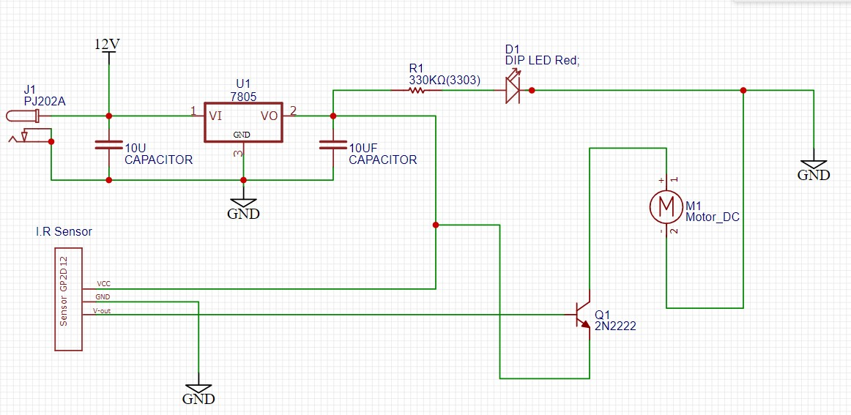
PART 1

Slide 15
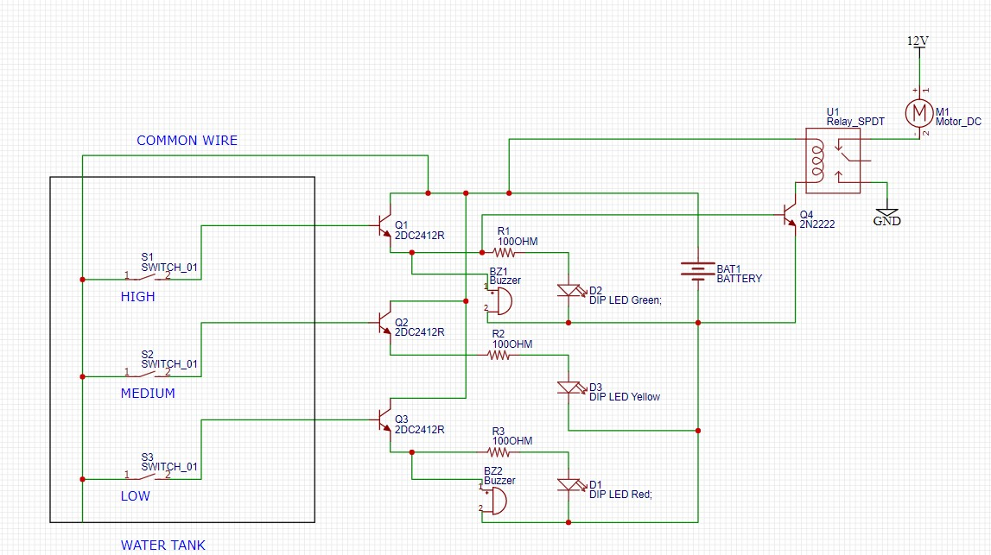
PART 2

Slide 16
05
WORKING
AUTOMATIC WATER DISPENSER

Slide 17
WORKING
PART 1
PART 2
Sensing the tank
Indicator and Controller

Slide 18
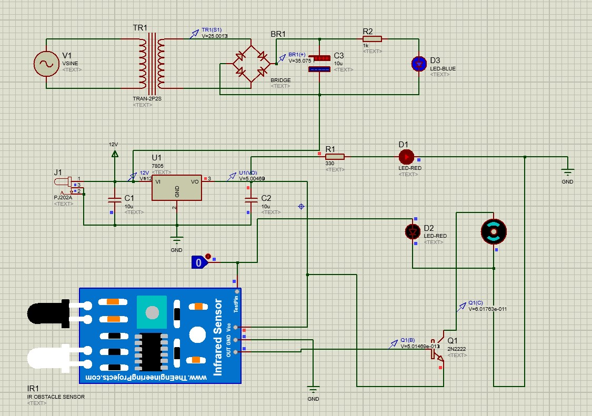
PART 1
The main function of a transformer is to transfer AC electrical power from one circuit to another circuit while keeping the frequency level constant but with altered voltage, which means it increases or decreases the voltage based on the requirement of the machines.
A Step Down Transformer is the one which reduces the output voltage that means it functions for converting high voltage with low current into a low voltage with high current.
The working of the device is quite simple, the main components involved are transistor, voltage regulator ,motor and I.R sensor.
Power Supply is given to the voltage regulator.

Slide 19
PART 1
The resulting voltage available at the output of the voltage regulator energizes the I.R sensor.
A sensor basically works on the change in the input quantity being measured, for instance if we consider I-R (infrared) sensor, it is triggered only when an object cuts the line of the infrared beam.
The I.R sensor detects the presence of objects in the close vicinity of the sensor and sends the signal to the transistor which performs the switching action and supplies power to the motor so that the valve opens and the led glows.
The flow of water will stop when we remove the object.

Slide 20
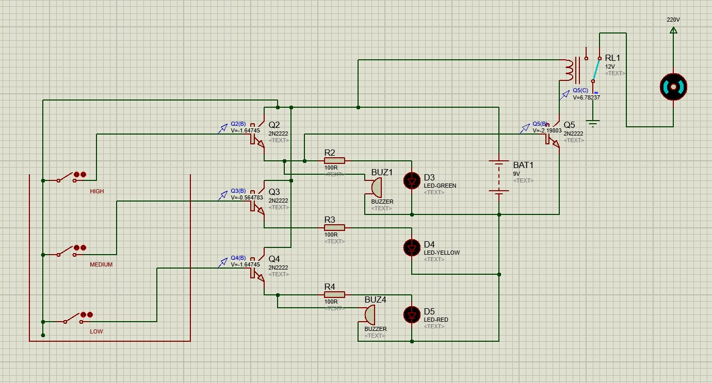
PART 2
A water level indicator may be defined as a system by which we can get the information of water level within the reservoir.
The operation of water level controller works upon the fact that water conducts electricity due to the presence of minerals within it. Thus water in the tank can be used to close a circuit. As the water level rises, different circuits in the controller send different signals.
In this project we have used four probes which are adjusted at four different levels in such a way that the three of them are used to sense the three levels high, medium and low respectively of water in the tank.
The fourth probe is used as common and reference level to the three probes.

Slide 21
PART 2
In this project we have also used three LED indicators namely Red (Low), Yellow (Medium) and Green (High) and two buzzers parallel to the green and red LED’s which are connected to the three transistors.
The four segments of insulated conducting probes are immersed within the water tank by placing their naked ends at various above mentioned levels with the help of a rod.
Once the high level is sensed by probe in the water tank, the Green LED blinks and the buzzer buzzes indicating the tank is completely filled which in turn automatically switches the motor OFF by the relay switching mechanism so as to avoid wastage of water.

Slide 22
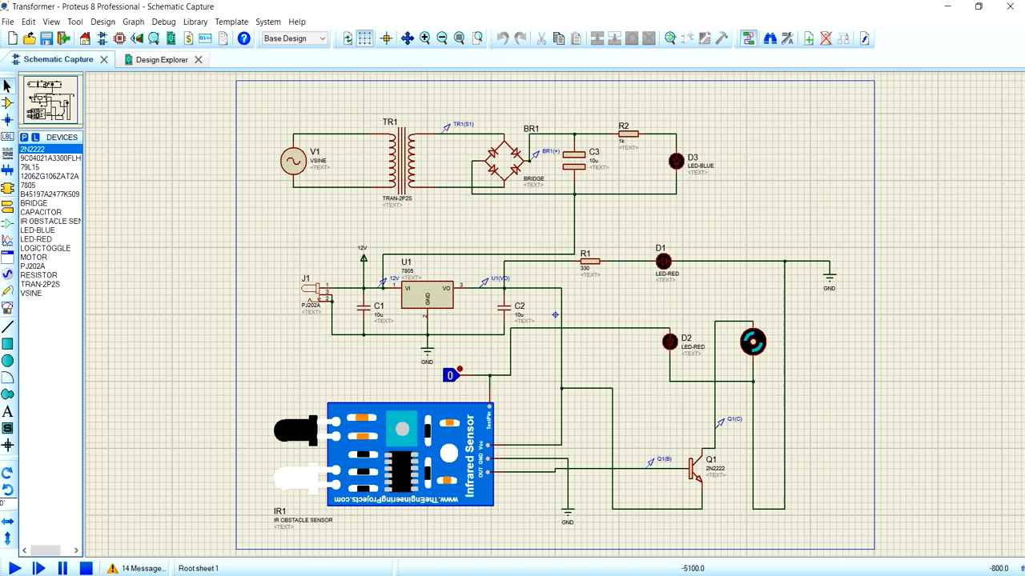
PART 1

Slide 23
06
HARDWARE DESCRIPTION
List Of Main Hardware Components

Slide 24
LIST OF HARDWARE COMPONENTS
 | AVAILABLE |  | QUANTITY | INDIVIDUAL PRICE | TOTAL PRICE
IR SENSOR (Electronicspices) |  |  | 1 | 65 | 65
VOLTAGE REGULATOR |  |  | 1 | 9 | 9
CAPACITOR |  |  | 3 | 3 | 9
RESISTOR |  |  | 5 | 3 | 15
LED
5
7
35
MOTOR (Electronicspices) |  | 1 | 79 | 79
TRANSISTOR |  | 5 | 3 | 15

Slide 25
LIST OF HARDWARE COMPONENTS
 | AVAILABLE | QUANTITY | INDIVIDUAL PRICE | TOTAL PRICE
BATTERY |  | 1 | 23 | 23
BUZZER |  | 2 | 8 | 16
RELAY(SONGLE) |  | 1 | 18 | 18
TOTAL |  |  |  | 284

Slide 26
PROJECT SCHEDULE
WEEK 1
WEEK 2
WEEK 3
WEEK 4
WEEK 5
WEEK 6
WEEK 7
WEEK 8
WEEK9
TOPIC DISCUSSION
APPROVAL OF TOPIC
PART 1 OF PROJECT
PART 2 OF PROJECT
MODIFIACTION OF CIRCUIT
PRESENTATION
DISCUSSION ON WORKING OF PROJECT
MOCK REVIEW
DISCUSSION ON REPORT PATTERN

Slide 27
07
SOFTWARE DESCRIPTION
PROTEUS

Slide 28
PROTEUS
For our mini project, we have used the Proteus software in which we have done the simulation part.
The Proteus Design Suite is a proprietary software tool used primarily for electronic design automation. It is a windows application for schematic capture, simulation, and PCB layout design. The software is used mainly by electronic design engineers and technicians to create schematics and electronic prints for manufacturing PCB.
Proteus is a Virtual System Modelling and circuit simulation application. The suite combines mixed mode SPICE circuit simulation, animated components and microprocessor models to facilitate co-simulation of complete microcontroller based designs.

Slide 29
08
SOFTWARE IMPLEMENTATION AND RESULTS
AUTOMATIC WATER DISPENSER

Slide 30
SOFTWARE IMPLEMENTATION
For this project, Proteus software is used.
This software not only helps to speed up the process of designing, but also avoid unnecessary mistake before the actual thing is build.
ISIS Proteus simulation is a software tool that can design a schematic diagram and make a simulation of the circuit.
It is easy to use this program because we can design our own circuit and simulate it.
We can check if the simulations work properly or not and make changes accordingly.
We have made two circuits, the first one, is about dispensing of water and second part, is about indication and controlling of the water.

Slide 31
RESULTS

Slide 32
RESULTS

Slide 33
09
CONCLUSION
AUTOMATIC WATER DISPENSER

Slide 34
CONCLUSION
The automation of the water distribution system eliminates not only water wastage but also provides continuous water flow according to the set point.
This project is automatic so it reduces lots of manpower.
By using this system people can save electricity charge and very less maintenance charge to this equipment is required.
There is no power failure or load shedding situation at any times.
Therefore, it is the most reliable renewable power or electricity resource with the least expenditure in the globe.
It reduces the energy and time.

Slide 35
10
FUTURE SCOPE
AUTOMATIC WATER DISPENSER

Slide 36
FUTURE SCOPE
The proposed system is the design of automatic water dispenser and water level monitoring using IR Sensor.
There is no limitation for improvisation, different ideas can reflect the changes in the way it is implemented.
In future we can replace IR Optocoupler sensor by photo detective sensors to make the system for limited or particular detection. Image processing technique is best for this system.
We can interface system with keyboard. That enables people to interact with it when buying water.

Slide 37
APPLICATIONS
AUTOMATIC WATER DISPENSER

Slide 38
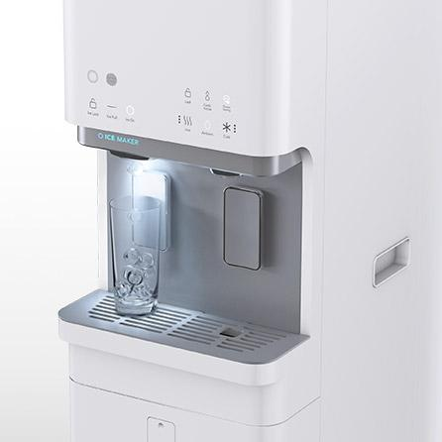
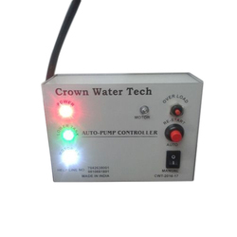
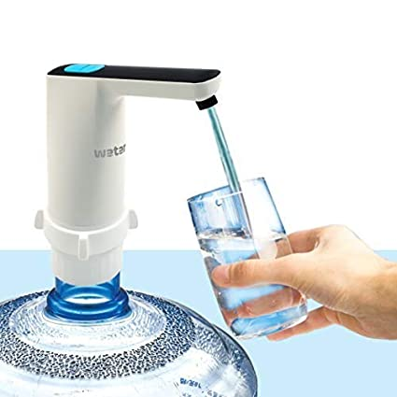
APLLICATIONS
Shopping Malls
Community Centers
Universities
Supper Stores
Petrol Pumps
CNG Stations
Companies can reduce man power and save the money
Home Apartments
Factories
Hotels
Agricultural Purposes
Beneficial in COVID-19 situations

Slide 39
REFERENCES
ijarece.org/wp-content/uploads/2017/12/IJARECE-VOL-6-ISSUE-11-1287-1290.pdf
hyclassproject.com/design-and-construction-of-coin-based-water-dispenser-system.html
www.electroniclinic.com/automatic-water-tap-without-using-arduino/
www.electroinvention.co.in/automatic-water-pump-controller
www.electronics-tutorials.ws/diode/diode_6.html
www.google.com/Automatic Water Dispenser-format.pdf
Igbinoba, C.K. and Okhaifoh, J.E., Automatic Indoor Water Dispensing Machine, Nigerian Research Journal of Engineering and Environmental Sciences 4(1) 2019 pp. 460-467.
Anuradha , Shweta Jadhav, Sridevi Mahamani, Smart Water Dispenser and Monitoring Water Level in IoT and Android Environment, International Journal of Computer Sciences and Engineering Research Paper Vol.-7, Issue-5, May 2019.

Slide 40
THANK YOU!

Slide 41
Any questions please

